Slide 1

An In-depth Analysis of Crime Patterns and Socioeconomic Influences in Chicago
Strategies for Violence Reduction in Chicago
Presented by: Azhan Saleem
Instructor: Dr. Denise Philpot

Slide 2
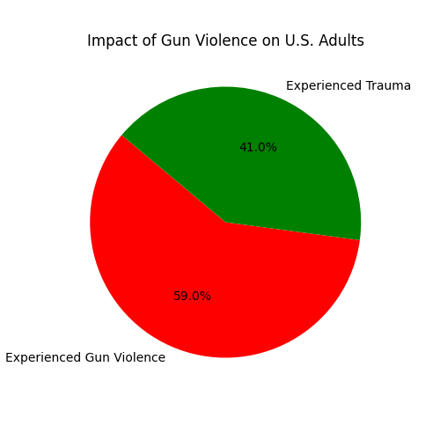
01
Introduction
Gun violence in the U.S. is 13 times higher than in other high-income countries. From 2015 to 2022, around 19,000 people were victimized by gunshots. This epidemic affects all demographics and socio-economic groups.

Slide 3
02
Literature Review
Effect of time of day on crime severity
Distribution of crime rates across different income levels
Analyze interventions or strategies addressing crime in high-crime districts
Factors influencing fata outcomes in gun-involved incidents
Predicting and Preventing Gun violence

Slide 4
03
Root Causes of Gun Violence
Key factors contributing to gun violence include poverty, unemployment, untreated mental illness, gun culture, and the availability of firearms. These factors create an environment where violence can thrive.

Slide 5
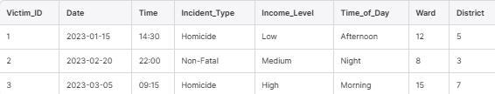
04
Dataset Overview
The dataset spans from 1991 to the present, focusing on homicides and non-fatal shootings. It includes variables like ZIP_CODE, WARD, and COMMUNITY_AREA, with a total of 38 columns and 61,000 observations.

Slide 6
5.1
Research Questions
Q.1: What impact does the day have on the frequency and severity of crimes, and how do these disparities impact communities?
Crime rates in Chicago are highest on weekends, particularly on Saturdays and Sundays. The severity of crimes, including incidents involving gun violence, also peaks during these days. This pattern suggests that weekends are high-risk periods for violent crime.
The increased crime frequency and severity on weekends disproportionately affect communities with higher poverty and unemployment rates. These communities often lack resources to effectively combat the surge in crime, leading to heightened fear and reduced quality of life.

Slide 7
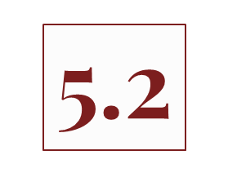
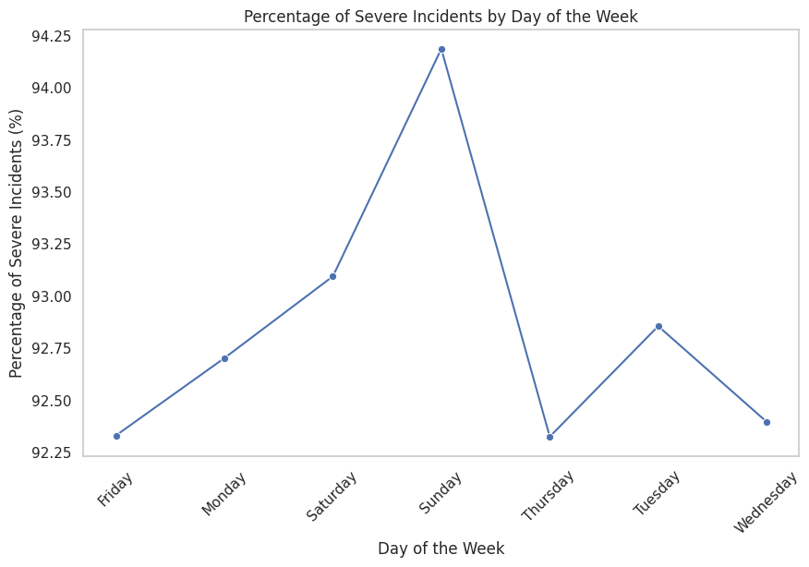
Crime Severity by Day of the Week

Slide 8
5.3
Research Questions
Q.2: What is the distribution of crime rates and types across different income levels, and what policies are beneficial in addressing these disparities effectively?
Crime Distribution: Violent crimes, such as battery and homicide, are more prevalent in low-income neighborhoods. These areas experience higher crime rates due to socioeconomic stressors like poverty and unemployment.
Effective Policies: Policies that focus on economic development, job creation, and improved access to education and social services are crucial in addressing these disparities. Community-based programs that provide support and resources can help mitigate the impact of socioeconomic factors on crime rates.

Slide 9
5.4
Crime Type | Correlation with % Aged 25+ Without HS Diploma
Battery | Moderate correlation observed with varying percentages, indicating an increase in incidents with higher percentages of individuals without a diploma.
Criminal Sexual Assault | No incidents recorded across all education levels, suggesting a potential underreporting or low prevalence in the sampled data.
Homicide | Shows varying trends with fluctuations, indicating that higher percentages may correlate with increased homicide rates
Non-Fatal Robbery | Fluctuations observed; however, the relationship appears weak overall.
General Trends | As the percentage of individuals without a high school diploma increases, crime rates for certain types (like battery and homicide) may also increase, reflecting potential social factors at play
Notes:
This section analyzes the relationship between crime rates and the percentage of individuals aged 25 and over without a high school diploma. The data presents various incidents of crime alongside the corresponding percentage of individuals lacking a high school education.

Slide 10
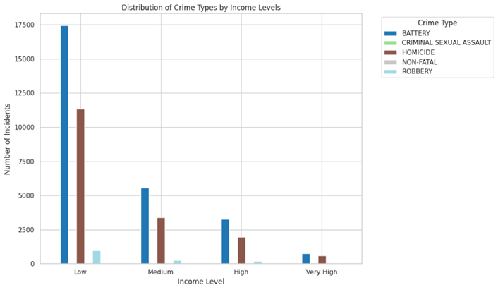
5.5
Crime Distribution by Income Level

Slide 11
5.6
Research Questions
Q.3: What are the most common crimes occurring in districts, and how do they compare in frequency in the top five high-crime districts?
Common Crimes: Battery and homicide are the most common crimes in high-crime districts. Districts 11, 7, 6, 10, and 3 have the highest crime rates, with District 11 leading in overall incidents.
Comparison: While battery is widespread across all top districts, homicide is more concentrated in Districts 7 and 6. This indicates a need for targeted interventions in these areas to address specific types of violent crime.

Slide 12
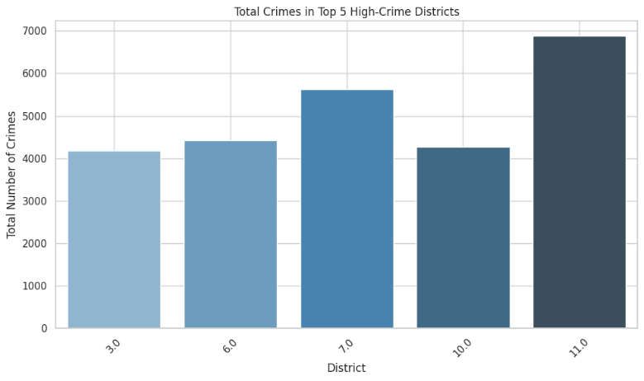
5.7
Top Five High Crime Districts

Slide 13
5.8
Research Questions
Q.4: What is the likelihood of fatality in incidents involving a gun?
Data Preparation:
Defined FATALITY_STATUS (1 for fatal incidents like homicide; 0 for non-fatal incidents such as battery, robbery).
Created GUN_PRESENT (1 if a gun was involved; 0 otherwise) to isolate cases of gun-related violence.
Key Findings:
Descriptive analysis shows that gun-related incidents have both fatal and non-fatal outcomes, with a notable share of fatalities.
Chi-Square Test revealed no significant association between gun presence and fatality (Chi-Square = 0.0, p = 1.0).
.

Slide 14
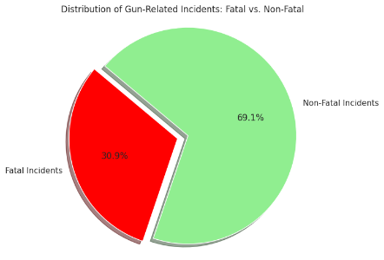
5.9
Logistic Regression Model
Logistic Regression Model:
Built to predict FATALITY_STATUS based on GUN_PRESENT.
Coefficient for GUN_PRESENT: -0.8035, significant with p = 0.000.
A negative coefficient suggests that in this dataset, gun presence is not strongly associated with increased fatality likelihood, indicating that other variables may influence fatality more significantly.
Equation Used:
P (Y=1∣ X) = 1 / 1+e−(β0 +β1 X1 +β2 X2 +⋯+βn Xn )
Where:
P (Y=1∣ X) is the probability that the out-come Y is 1 (the event of interest) given predictors X.
β0 is the intercept term from the logistic regression model.
.

Slide 15
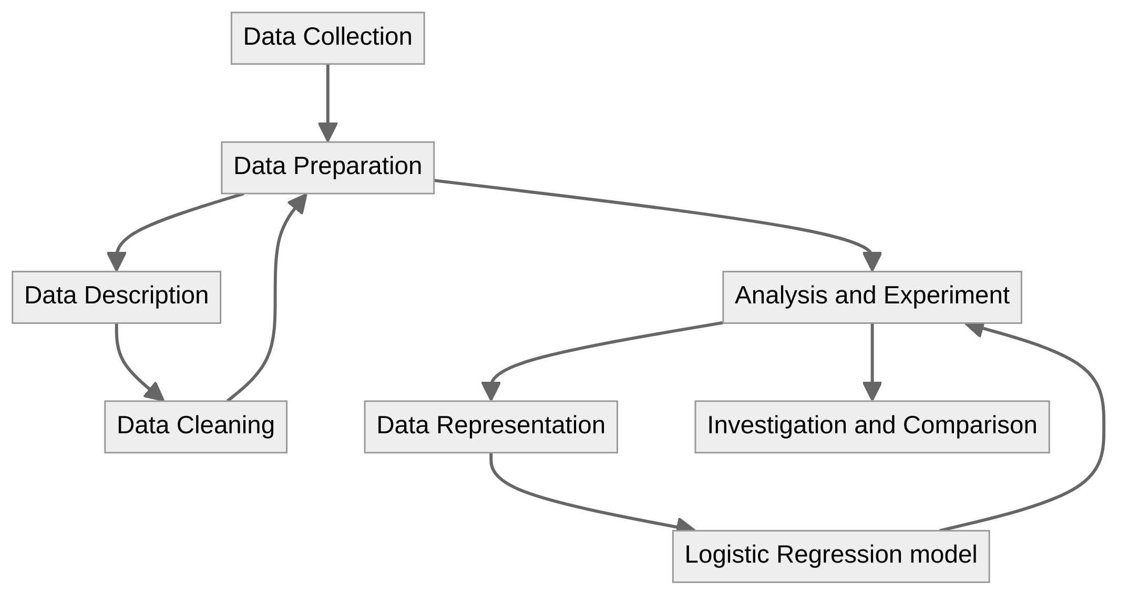
06
Research Methodology
Utilizes quantitative research design. Data was collected from the CPD and U.S. Census Bureau, then cleaned, validated, and analyzed to identify crime patterns and socioeconomic factors.

Slide 16
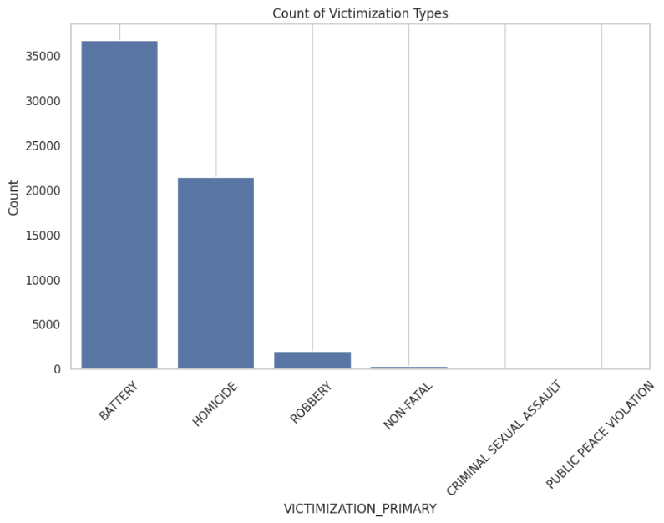
07
Temporal Patterns of Crime
Crime rates increase on weekends, with the highest incidents on Saturdays and Sundays. Late-night and early morning hours see the most activity, particularly on weekends.

Slide 17
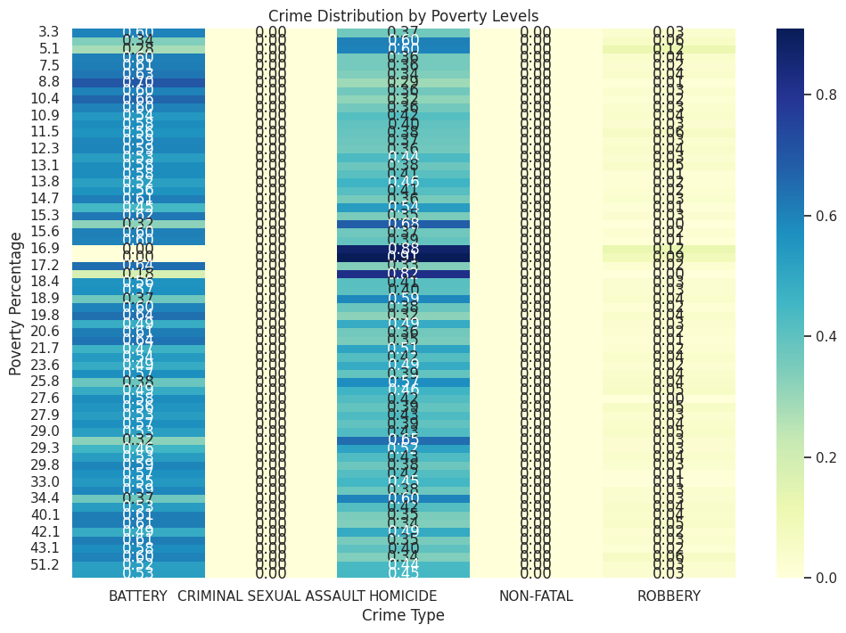
08
Socioeconomic Impact on Crime
Socioeconomic factors like income and poverty correlate strongly with crime rates. Low-income areas experience higher rates of violent crime.

Slide 18
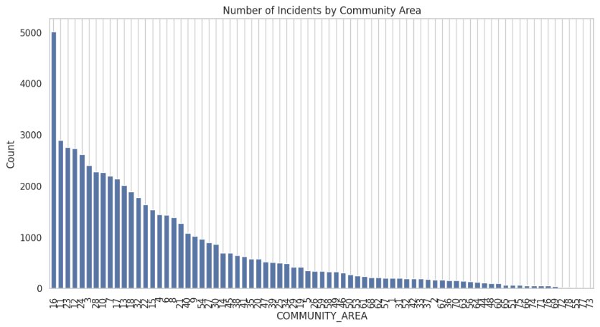
09
Community Impact Disparities
Crime disproportionately affects certain communities, particularly those with high poverty and unemployment. Areas like Roseland and Englewood are hotspots.

Slide 19
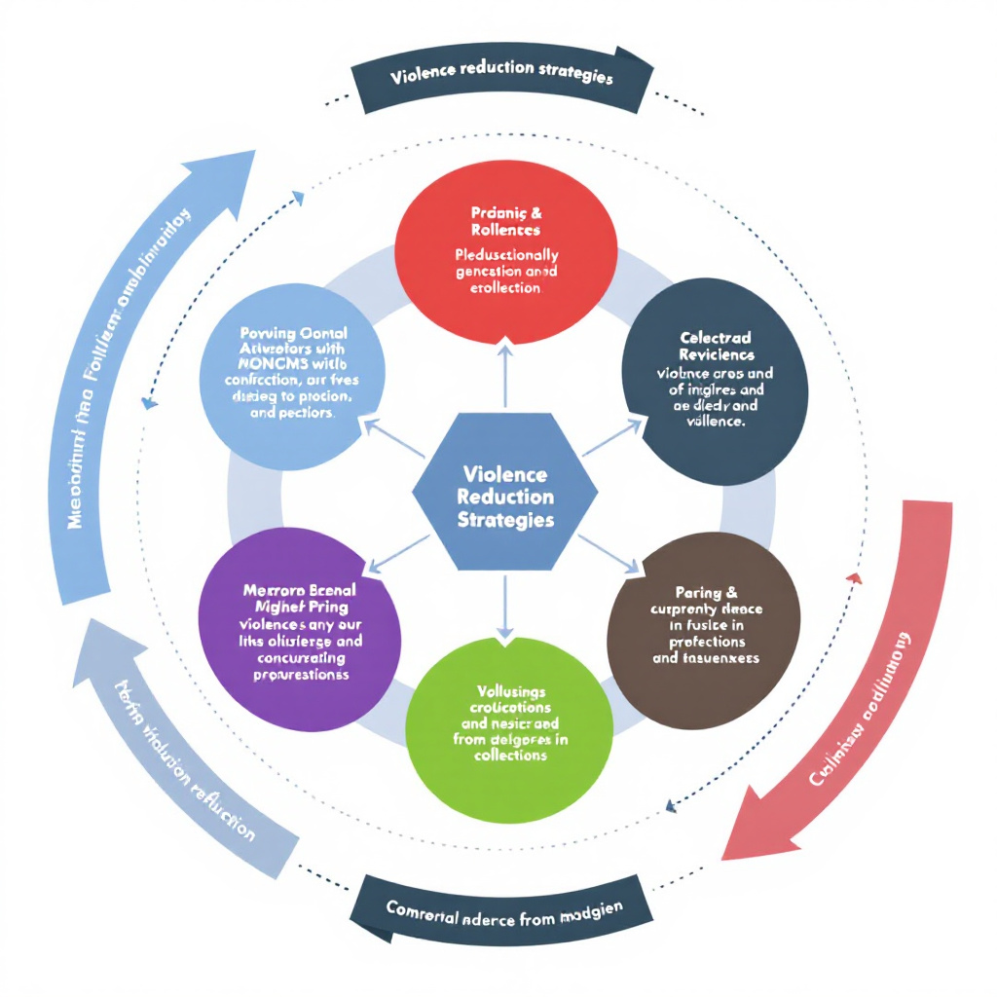
10
Violence Reduction Strategies
Key strategies include community policing hot spot
policing, and focused deterrence. These interventions
target high-crime areas and times.

Slide 20

11
Effectiveness of Community Policing
Community policing builds trust and cooperation between police and residents, leading to reduced crime rates and improved community relations.
Socioeconomic Influence: Violent crime rates are linked to socioeconomic factors.
Long-term Solutions: Focus on poverty alleviation, job creation, and affordable housing.
Targeted Policing: Increase patrols and surveillance during high-crime times (nights and weekends).
Community Policing: Build trust and relationships with residents to enhance safety and crime reporting.
Policy Focus: Prioritize long-term socioeconomic strategies over short-term fixes.

Slide 21
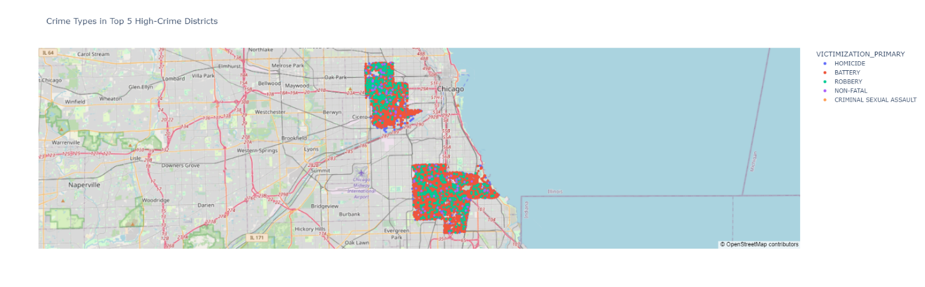
12
Hot Spot Policing
Focuses on areas with high crime rates, utilizing increased patrols and resources to deter criminal activity.

Slide 22
13
Socioeconomic Interventions
Improving economic conditions through job creation and social services can significantly reduce crime rates in affected areas.

Slide 23
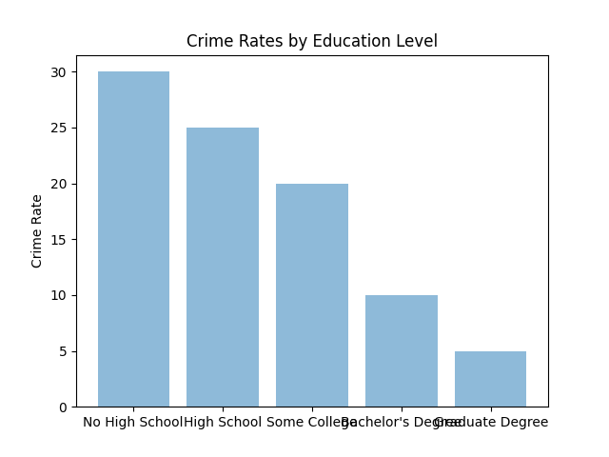
14
Education and Crime Reduction
Higher education levels correlate with lower crime rates. Initiatives to improve education can lead to long-term crime reduction.
15
Employment and Crime Prevention
High unemployment rates correlate with increased violent crime rates, particularly in low-income neighborhoods. Areas with unemployment rates above 15% show significantly higher incidences of violent crimes like battery and homicide.
Initiatives such as READI Chicago have been effective in reducing gun violence by providing employment opportunities and behavioral therapy to high-risk individuals, addressing root causes of crime through economic stability.

Slide 24

16
Gun Control Measures
Gun Control's Role: While guns are involved in a significant portion of violent crimes, statistical analysis shows no direct correlation between gun presence and fatality rates. This suggests that other factors also influence the severity of incidents.
Successful Policies: Effective measures include strict background checks, licensing requirements, and community-based interventions like violence interruption programs, which have shown success in reducing gun-related incidents.

Slide 25
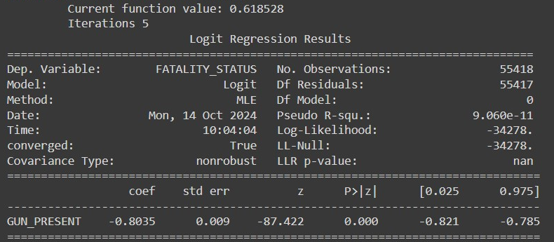
Model Evaluation
17

Slide 26
18
Regression Output
Coefficient | Standard Error | Z-Statistic | P-Value | Confidence Interval (95%)
GUN_PRESENT | -0.8035 | 0.009 | -87.422 | 0.000

Slide 27
19
Public Health Approaches
Public health strategies in violence prevention include mental health services and community support programs to address root causes.
The strategies for addressing crime rates in cities, particularly Chicago, including:
Examine environmental features.
Use micro geographic data.
Decompose impact of air pollution.
Incorporate public health in crime prevention.
Integrate air quality in violence control schemes.
Encourage subsequent research on violence in metropolitan areas.

Slide 28

20
Media's Role in Crime Perception
Media portrayal can affect public perception of crime and influence policy. Discuss strategies for responsible reporting.

Slide 29
21
Policy Recommendations
Integrated Approaches: Policymakers should implement comprehensive strategies combining law enforcement with community programs and socioeconomic development. This includes increasing police presence during high-risk periods and investing in economic development in high-crime areas.
Targeted Interventions: Allocate resources to districts with high crime rates, focusing on job creation, education, and social services to address underlying causes of crime.

Slide 30

22
Conclusion
Crime rates are significantly influenced by socioeconomic factors such as income, poverty, and unemployment. Violent crimes are more prevalent in low-income areas, with weekends showing higher crime rates.

Slide 31

23
Future Directions
Further research should explore the impact of mental health, substance
abuse, and social networks on crime patterns. Advanced predictive
modeling and geospatial analysis can help identify emerging crime trends
and inform targeted interventions.

Slide 32

24
Thanks!

